Slide 1
Exploratory Data Analysis
On Titanic Dataset

Slide 2
Introduction
The titanic dataset contain information about the passengers aboard the titanic ship ,Which sank its maiden voyage.
Dataset includes detail such as passengers’ age, class, fare,sex,survived,name
The objective of EDA is to uncover meaningful insights of this data Analysis (EDA)is to uncover meaningful insights from this data by identifying trends, relationships and key patterns.

Slide 3
Data discription
Pclass:Passenger classs(1=first,2=second,3=third)
Age:age of passenger in years
Fare:the fare paid by passenger
Survived:Yes=1 ,No=0
Sex:gender of passenger
Categorical data sexand embarked column were coverted into numeric values to facilitate analysis

Slide 4
EDA
Descriptive statestic:
Age of passenger range from 0.17 to 76 with an average age of 30 years. fare range from 0 with average fare 35.63 .fare has heigh standard deviation,indicating wide variation in fare prices,possible due to luxury cabin. median Age is 27 years and median Fare is 14 showing most passenger were younger and paid lower fares.

Slide 5
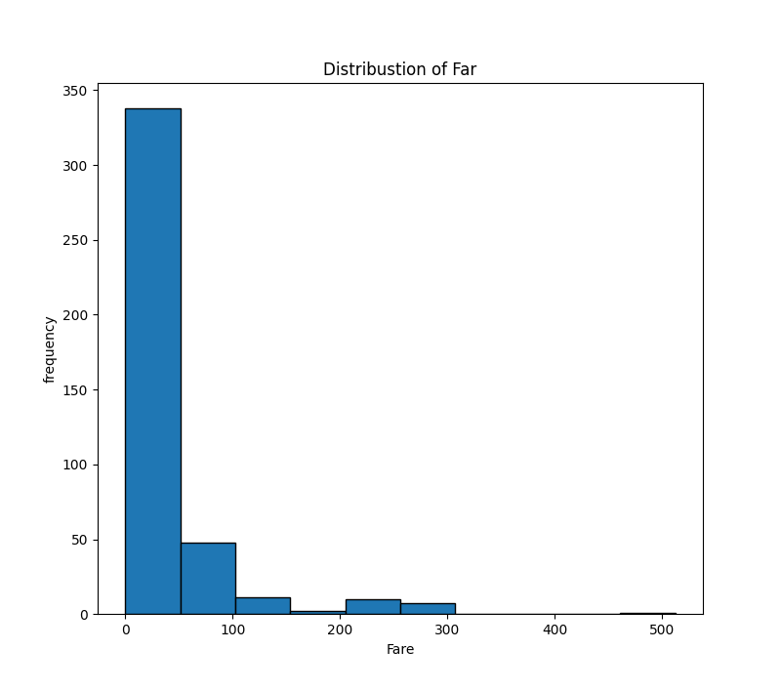
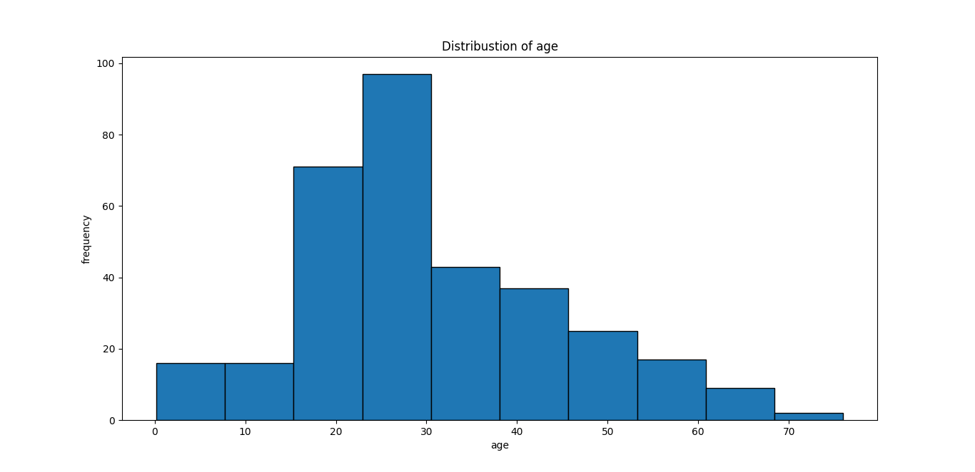
Visualization
The histogram for age shows that most passengers were between 20 and 30 years old. there are few very younge anf fewer vary old passengers.
The histogram for fare is risked-skewed most passenger paid relatively low fare but few paid vary high amt.

Slide 6
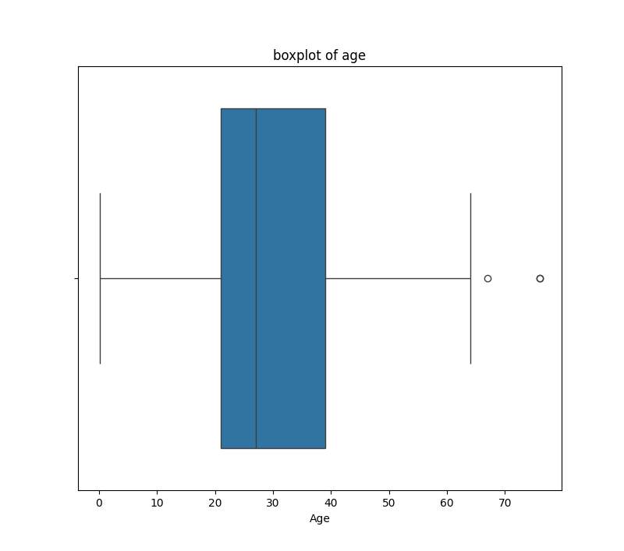
The box plot for age shows that majority of passengers were aged between 20 and 40 . In box plot two outlier were observed around the ages of 65 and 75 years.thye consider outlier bcz it beyond the typical range of passenger ages

Slide 7
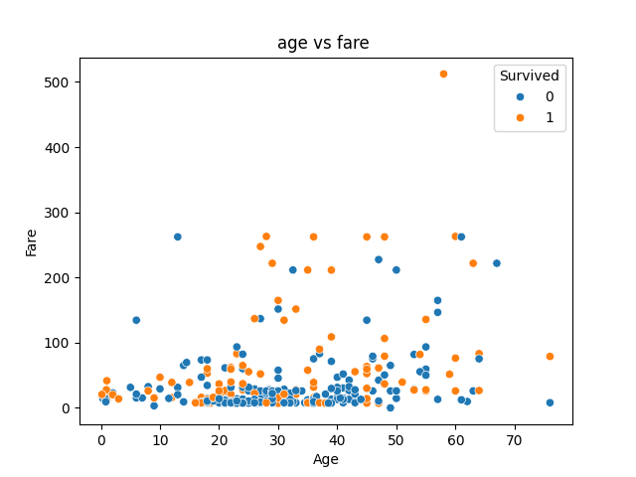
The scatter plot btw age and fare does not shows clear trend.passengers of all ages paid both low and heigh fair

Slide 8
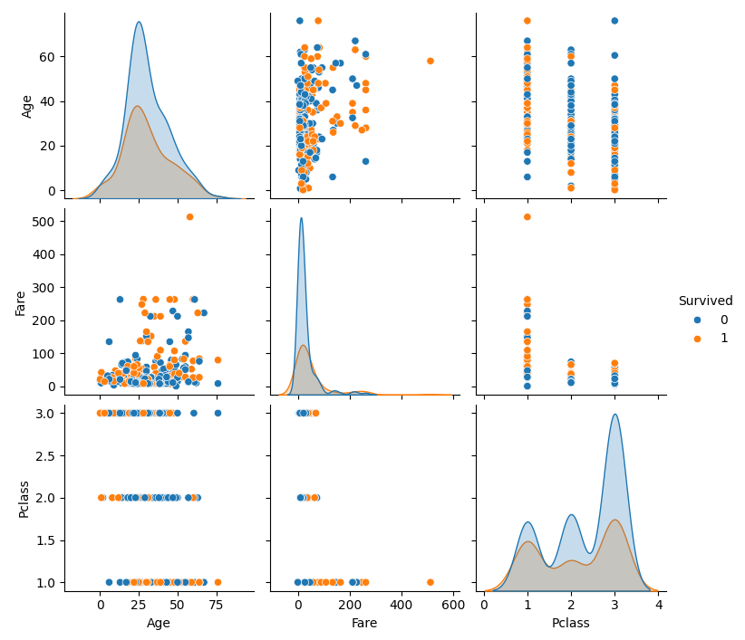
Blue=passenger ot survived
Red=passenger survived
1)Age =most passengers are old and survived(20-60)
2)Fare distribution=most fare are low ,some are vary expensive ticket
3)pclass=many people in 3rd class
There is no strong direction correlation btw age and fare.
3rd class passenger had better survival rate

